Slide 1
White House Logs
DSC640-T301 Data Presentation & Visualization
Joseph Damico

Slide 2
Importance of Data Collection
Accurate and complete data collection is vital for White House security. Every detail, no matter how small, contributes to effective decision-making and enhances situational awareness. Missing information can create gaps that compromise security operations. By ensuring thorough documentation, we strengthen our ability to protect our nation's leadership and maintain operational excellence. Let's commit to capturing every detail for a safer environment.

Slide 3
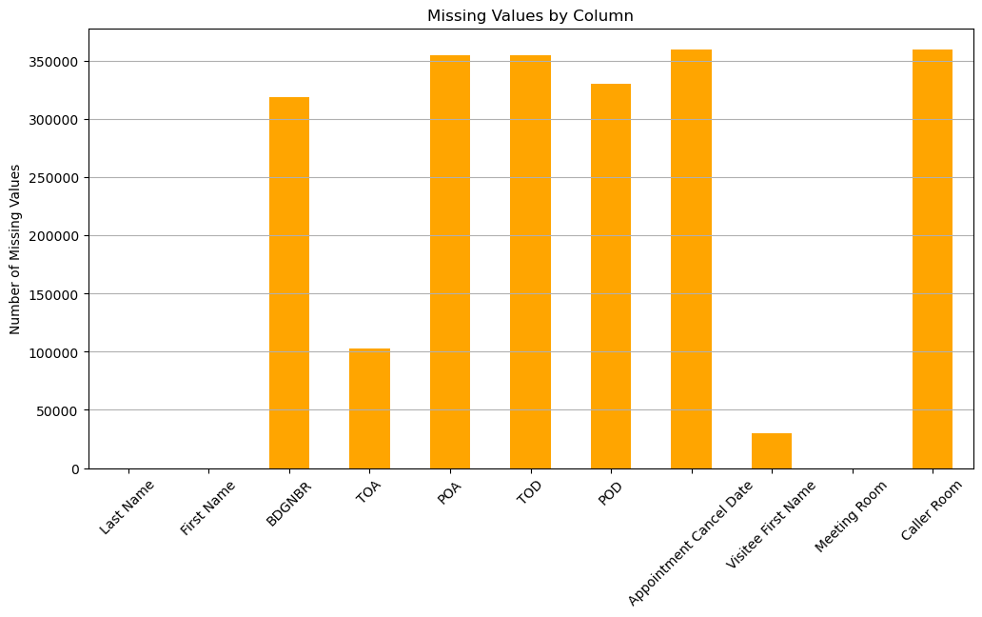
Missing Values by Column
This chart highlights significant gaps in our data collection. Notably, there are over 300,000 missing BDGNBR entries and substantial missing values for TOA, POA, TOD, and POD.
Addressing these gaps is crucial for enhancing our security protocols and ensuring comprehensive oversight.

Slide 4
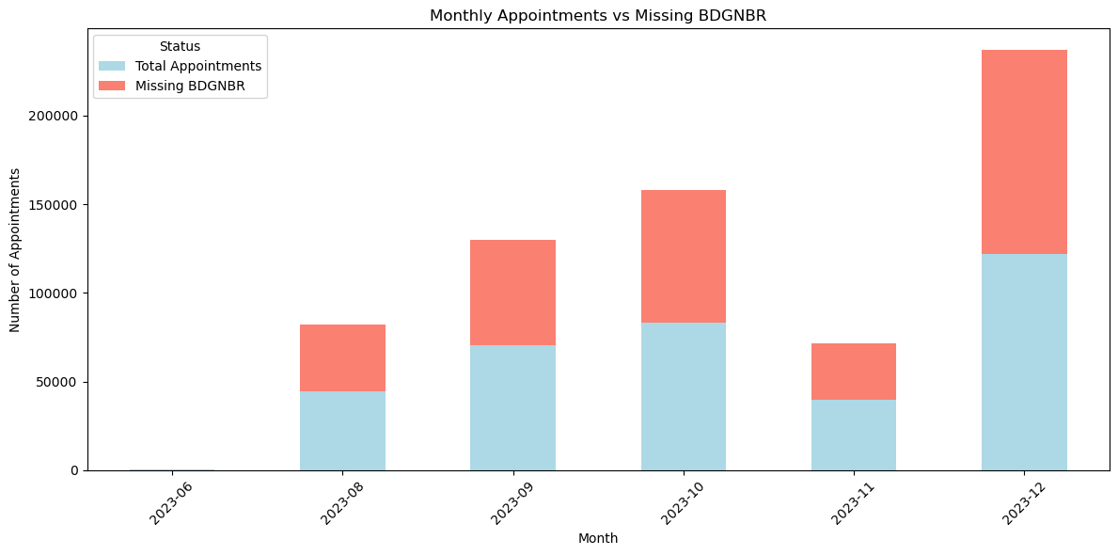
Missing BDGNBR vs Appointments
This chart illustrates the alarming disparity between total appointments and missing Badge Number data. With 41,267 total appointments, the staggering 318,834 missing Badge Number entries underscores a critical need for improved data accuracy.
This also highlights as we get closer to the end of the year we have an increasing number of missing Badge Numbers.

Slide 5
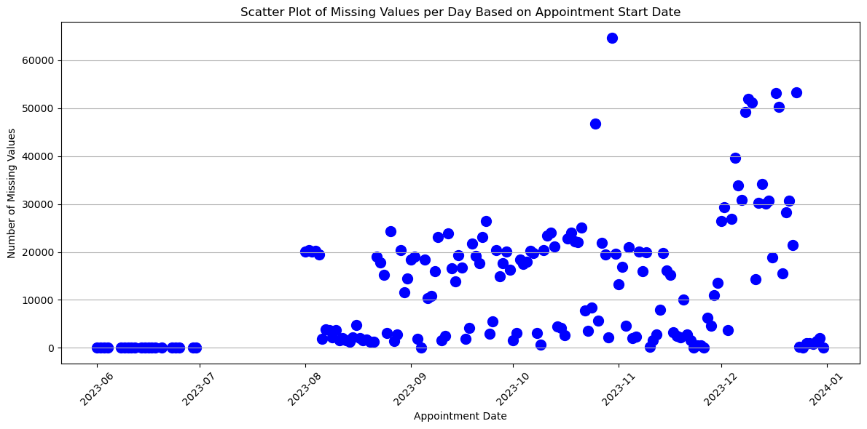
Missing Values vs. Date
This scatterplot reveals the daily distribution of missing values across key data fields, highlighting trends over time. An increase in missing data can be seen as we get closer to the end of the year showing ongoing data recording challenges.

Slide 6
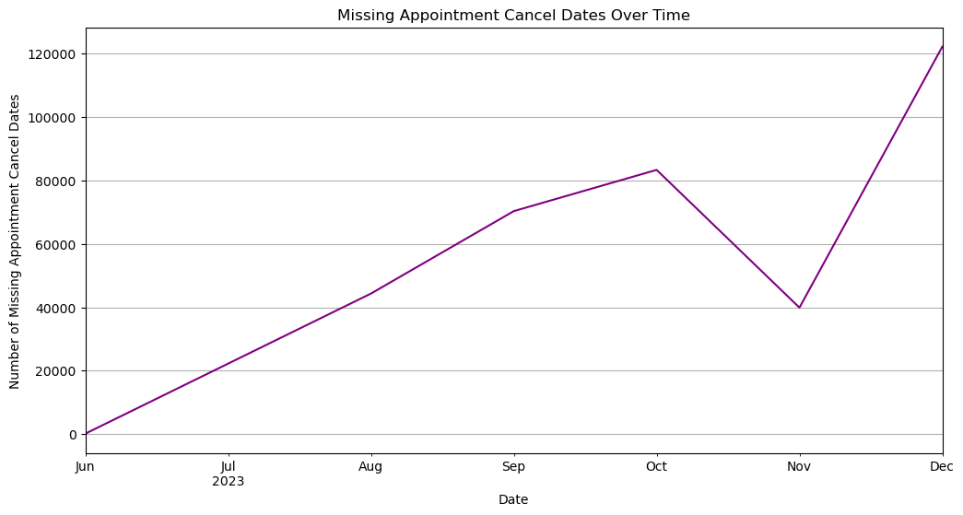
Missing Appointment Cancel Dates Over Time
This line chart highlights the number of appointments that were not canceled but left with blank fields. Instead of leaving these fields empty, we should record a value such as "Null" or "N/A“ to indicate that the appointment took place.

Slide 7
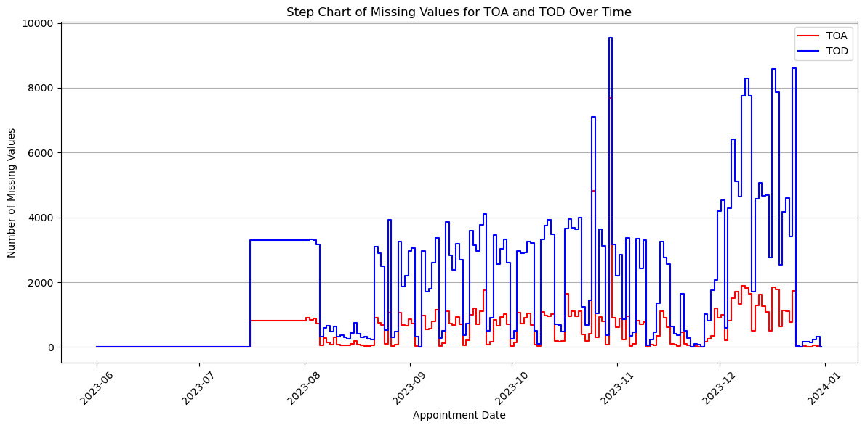
Missing Values for TOA & TOD
This step chart illustrates the missing values for Time of Appointment (TOA) and Time of Day (TOD). Accurately recording these times is crucial for understanding who is present in the building at any given moment. By ensuring we capture this information, we can better track attendance and improve our security protocols.

Slide 8
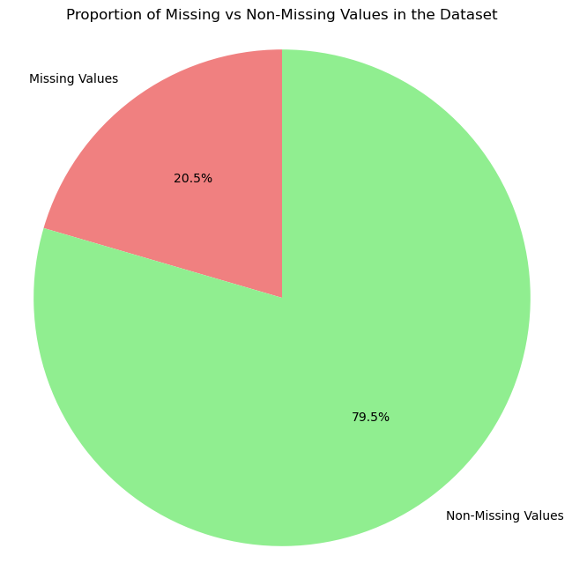
Pie Chart of Missing Values
This pie chart highlights the proportion of missing values within our dataset, showing a total of 20.5% missing values. This significant percentage of missing information underscores the urgency for improved data collection practices.

Slide 9
Call to Action
In summary, this analysis reveals critical gaps in data collection that directly impact our security operations. The missing values highlighted across various charts illustrate the need for consistent and thorough documentation. We urge all employees to prioritize accurate record-keeping, ensuring every appointment and access detail is logged. By improving our data practices, we can enhance security measures, facilitate better decision-making, and maintain the integrity of our operations at the White House.

